Slide 1
UAPP 702: Research Design for Urban & Public Policy
Babbie, The Practice of Social Research, Chaps.1-2
Danilo Yanich
School of Public Policy & Administration
Center for Community Research & Service
University of Delaware

Slide 2
Chapter 1: Knowing things
Not so much about what we know, but HOW we know
  perception
Most of what we know is matter of belief and agreement
  “Everybody knows that…”
  But everybody “knew” the world was flat once
Other way of knowing…direct experience, observation
  But when experience conflicts with agreement…
  There is good chance that we’ll surrender our experience in favor of agreement
Methodology: special approach to inquiry
  The science of finding out
  How social scientists find out about human social life

Slide 3
Errors in inquiry
Inaccurate observations
  Most daily observations are casual… not precise
  Scientific observation is a conscious activity
  Ex: instructor’s clothes; football toss
Overgeneralization
  Assuming that a few similar events are evidence of a general pattern
  Scientists guard against this by REPLICATION of inquiry
Selective observation
  We assume a pattern exists then focus on future events that fit the pattern
Illogical reasoning
  “Exception that proves the rule”
  WHAT?...how can that be logical?

Slide 4
Foundations of social science: logic and observation
Theory, not philosophy or belief
  Social theory has to do with what is, not with what should be...not so for many centuries.
  Science cannot settle debates about values
Social regularities
  Social affairs do exhibit a high degree of regularity, despite exceptions
Aggregates, not individuals
  Regularities that social scientists study generally reflect the collective behavior of many individuals
A Variable Language
  Attributes: characteristics or qualities that describe an object
  Variables: logical groupings of attributes

Slide 5
Variables & Attributes:
Some Common Social Concepts (Babbie Fig 1-4, p.15)
Female | Age
Upper class | African American
Young | Occupation
Social class | Gender
Race/Ethnicity | Plumber

Slide 6
Variables are sets of related values or attributes (Babbie Fig 1-4, p.15) cont.
Variable | Attribute
Age | Young, middle-aged, old
Gender | Female, male
Occupation | Plumber, lawyer, data-entry clerk…
Race/Ethnicity | African-American, Asian, Caucasian, Latino…
Social Class | Upper, middle, lower…

Slide 7
The Hardest Hit Was… which variable is operative for conclusion?
(sidebar, p.16)
 | Marin | Santa Cruz
Businesses destroyed | $15.0M | $56.5M
People killed | 5 | 22
People injured | 379 | 50
People displaced | 370 | 400
Homes destroyed | 28 | 135
Homes damaged | 2,900 | 300
Businesses destroyed | 25 | 10
Businesses damaged | 800 | 35
Private damages | $65.1M | $50.0M
Public damages | $15.0M | $56.5M

Slide 8
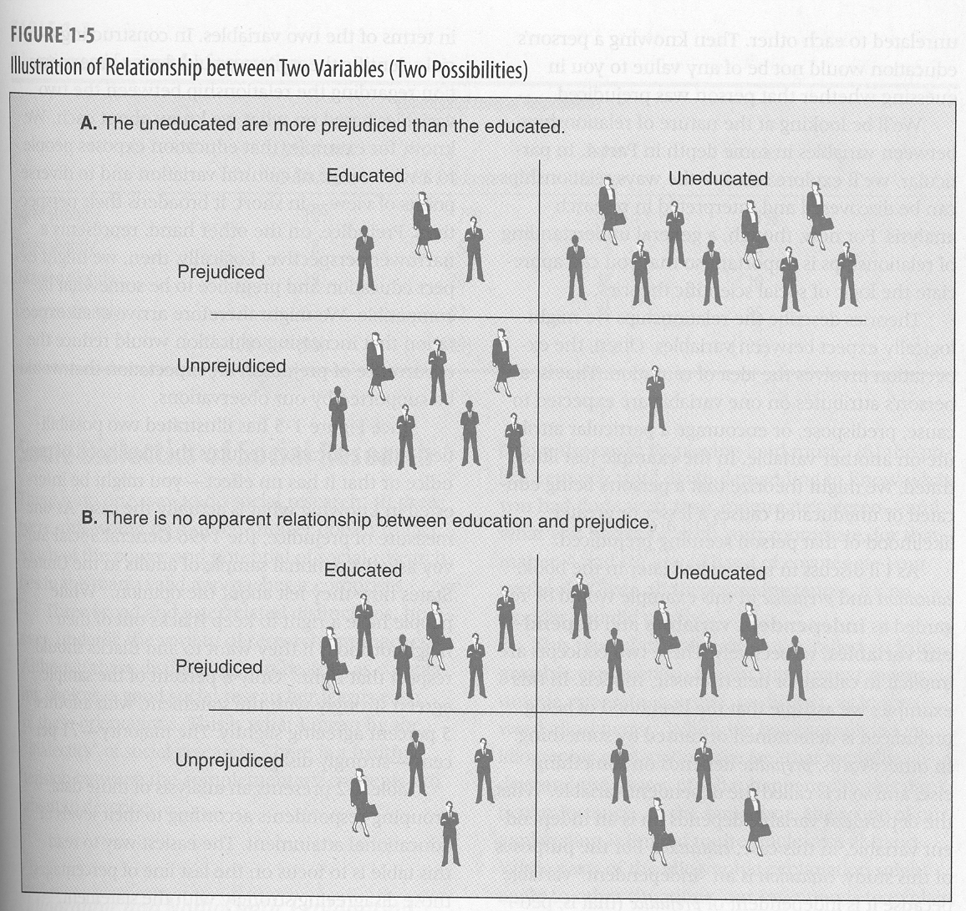
Illustration of relationship between two variables

Slide 9
Independent and Dependent Variables
Two concepts are implicit in causal or deterministic models
A dependent variable “depends” on an independent variable
That is, a change in the independent variable will produce a change in the dependent variable

Slide 10
Education and Anti-Gay Prejudice
Table 1-2, p.18
Level of education | Percent saying that homosexuality is always wrong
Less than HS graduate | 72
HS graduate | 62
Junior college | 56
Bachelor’s degree | 44
Graduate degree | 30

Slide 11
Dialectics of Social Research:
Idiographic and Nomothetic Explanations
Idiographic
  Fully understand what happened in a particular instance
  Scope of the explanation is limited to the case at hand
Nomothetic
  Seeks to explain a class of situations, rather than a single one
  Seeks to explain “economically” using one or a few explanatory factors
  Settles for a partial explanation rather than a full explanation
  Might qualify causal statements with “usually” or “other things being equal”, etc.

Slide 12
Dialectics of Social Research:
Inductive and Deductive Theory
Inductive
  Reasoning that moves from the particular to the general...from…
    1. a set of observations to…
    2. the discovery of a pattern that represents some degree of order among all the given events
Deductive
  Reasoning that moves from the general to the specific...from…
    1. a pattern that might be logically or theoretically expected to…
    2. observations that test whether the pattern actually occurs

Slide 13
Dialectics of Social Research:
Quantitative and Qualitative Data
Most simply put, difference is the distinction between numerical and non-numerical data
Every observation is qualitative at the outset
  We quantify it to make it easier to aggregate, compare and summarize the data
  Use Babbie example re: age, . p 24 (“older than his years”)
Both types of data are useful and legitimate in social research

Slide 14
Pure & Applied Research
Knowledge for knowledge’s sake
Example of Egyptian sociologist who wrote about regimes who groom sons for power---NOT allowed
Different circumstances in policy research in SPPA, but effort is directed at informing public policy

Slide 15
Ch2: Paradigms, Theory & Social Research
“You can observe a lot just by watching.”
    ----Yogi Berra, 20th century philosopher
But, if only observe patterns, we will fail
  Need to offer logical explanations for the patterns
  Or the regularities we observe may be mere flukes
Enter theories
  Prevent us from being taken in by flukes
  Suggest other possibilities for the patterns we observe
  Direct research efforts to most likely places

Slide 16
Social Paradigms
Paradigm
  The fundamental models or frames of reference we use to organize our observations and reasoning
Difficult to recognize because they are so implicit…
  Seem more like “the way things are” than one possible point of view among many
Ultimately, paradigms are not true or false…
  They are only more or less useful

Slide 17
Macrotheory and Microtheory
A distinction that cuts across many paradigms
Macrotheory
  Study of society at large or large portions of it
  Ex: struggle between economic classes; interrelations among major institutions
  Deals with large, aggregate entities of society
Microtheory
  Deals with issues of social life at the levels of individuals and small groups
  Ex: dating behavior; jury deliberations

Slide 18
Some social science paradigms
Early Positivism
  Auguste Comte identified society as a phenomenon that could be studied scientifically
  Comte postulated three stages of history
    Theological---religious paradigms explained reality
    Metaphysical---natural laws replaced God as explanation
    Positivist---science would replace natural law in which knowledge would be based on observation rather than on belief or logic alone

Slide 19
Some social science paradigms, p.2
Social Darwinism
  application of Darwin’s process of natural selection to social affairs
    Ex: Journey from hunter/gather tribes to complex, industrial societies seen as “fitter” forms of society
Conflict paradigm
  social behavior best be seen as a product of conflict

Slide 20
Some social science paradigms, p.3
Symbolic interactionism
  human interactions revolve around use of language and other systems
Ethnomethodology
  an attempt to make sense of the one’s life experiences
  People create their realities and social structure through their actions

Slide 21
Some social science paradigms, p.4
Structural Functionalism
  view of society as a social system with parts carrying out particular functions
Feminist paradigm
  calling attention to aspects of social life not revealed in other paradigms…
  particularly gender differences and their relation to the rest of social organization
Critical race theory
  looks at social world based on race awareness & racial justice

Slide 22
Rational Objectivity Reconsidered
Asch experiment (fig 2-1, p. 42)
  Six subjects are to pick line that matches the first line
  Obvious right answer but other subjects give “wrong” answers
  The experiment is about one subject and getting that subject to alter the answer to conform to an obviously wrong answer.
Excellent experiment to show that reality is a matter of communication and agreement

Slide 23
Rational Objectivity Reconsidered, p.2
Despite inescapable subjectivity of our experience
  we are “hard-wired” to seek agreement on what is really “real”...what is objectively so
Whenever we find a common ground in our subjective experiences, we say we are dealing with objective reality.
From 17th to mid-20th century, belief in an objective reality independent of individual perceptions dominated science...
  not as a useful paradigm, but as THE TRUTH
But ideal of objectivity conceals as much as it reveals...
  In the past what was regarded as objective reality in Western social science was actually an agreement primarily among middle-class European men.
  Portrayal by early anthropologists of native tribes as savages rather than looking at their own native logic.

Slide 24
Rational Objectivity Reconsidered, p.3
Critical realism
  define reality as that which can be seen to have an effect on society
  prejudice, loyalty, etc.
W.I. Thomas…
  “If men define situations as real, they are real in their consequences”
  Tiger vs chair

Slide 25
Elements of Social Theory
Law: universal generalization about classes of facts
  Ex: law of gravity—bodies are attracted to each other in proportion to their mass and in inverse proportion to their distance
  No social scientific laws that claim universal certainty
Theory: a systematic explanation for observations that relate to a particular aspect of social life...
  For example someone might offer a theory of juvenile delinquency, prejudice, homelessness, political revolution

Slide 26
Elements of Social Theory, p.2
Proposition: specific conclusions about the relationships among concepts that are derived from axiomatic groundwork
Hypothesis: a specified testable expectation about empirical reality that follows from a more general proposition
  Research is designed to test hypotheses
  Null hypothesis suggests that there is NO relationship among the variables under study

Slide 27
Traditional model of science
Theory
Operationalization
  Specification of the exact operations involved in measuring a variable
  For the researcher testing an hypothesis, the meaning of variables is exactly and only what the operational definition specifies
  Must be specified with clarity in a way to make observation precise and rigorous
Observation
  Systematic and rigorous gathering of data to test the hypothesis

